Slide 1

Examining the Relationship Between Water Availability and Adoption of Adaptation Measures
Annie Brinza
Jingjing Li
Nicole Levin
Investigator: Mariana Vedoveto
Notes:
My name is Annie Brinza, and my group mates are Jingjing Li and Nicole Levin. Our project this semester was to examine the relationship between water availability and adoption of adaptation measures in the Brazilian Amazon. The investigator of our project was Mariana Vedoveto

Slide 2
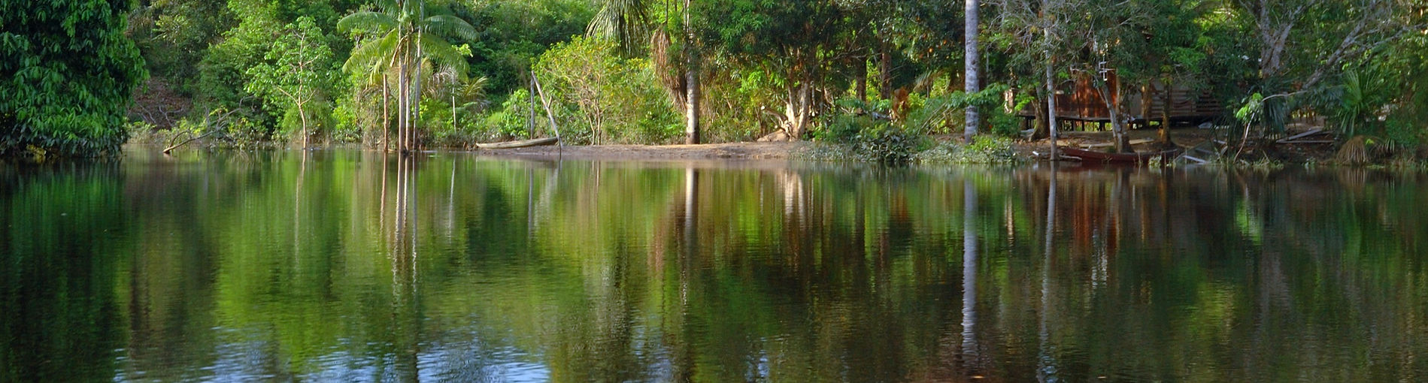
Project Background
Collaboration between 7 universities
Goal is to provide actionable knowledge about connections between water and rural production
Improve human well-being while conserving Amazonian ecosystems
Notes:
This project is a collaboration between seven universities and has spanned decades. The overall goal of the project is to provide researchers and policymakers with actionable knowledge about connections between water and rural production that can help local communities make informed decisions to improve human well-being while conserving Amazonian ecosystems.

Slide 3
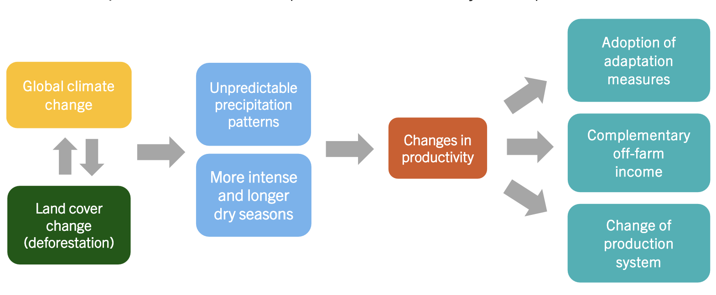
Project Background – Our Focus
Investigator Mariana Vedoveto is interested specifically in adoption of adaptation measures in response to water availability
Adaptation measures include cattle management, water management, pasture management, and forest conservation
Will use results of analysis to create recommendations for adaptation that minimizes further risk to ecosystem
Notes:
Our investigator’s hypothesis is that changes in water availability influence farmers’ decisions on adopting adaptation measures. For this project, four types of adaptation measures are considered – cattle management, changing from crops to cattle, water management, such as creating ponds on the land, pasture management, such as fallowing the land, and forest conservation, such as setting land aside for forest regeneration
If the relationship between the two can be better understood, recommendations can be made for how the farmers should adapt in a way that minimizes further risk to the ecosystem. As an example – if farmers are more likely to clear additional land in order to try and grow more crops with less water available, that deforestation can lead to worse climate instability and further water vulnerability (WORD BETTER).

Slide 4
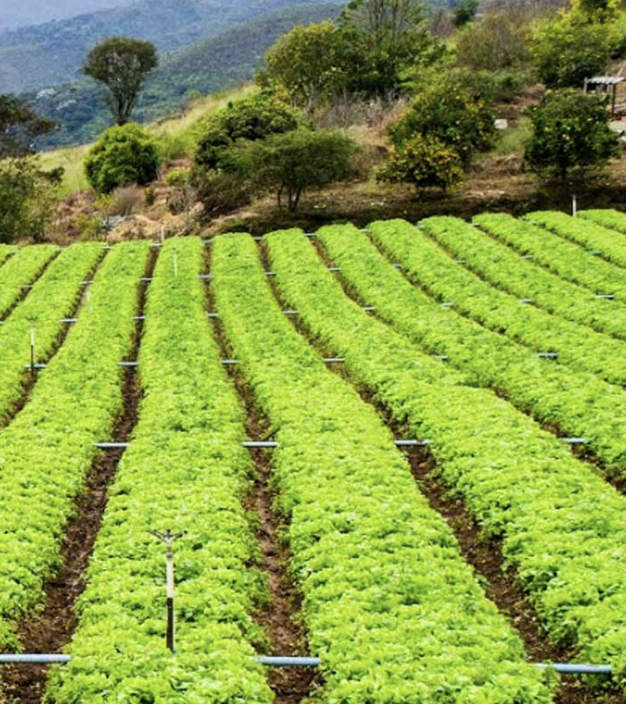
Research Questions
Is there a statistically significant relationship between water availability and the adoption of adaptation methods among rural farmers in Brazil?
How does this vary by level of wealth?
How does this vary by adaptation method?
Notes:
Now that you understand the project background, I would like to dive deeper into the research questions we worked on answering
The primary question of focus is: Is there a statistically significant relationship between water availability and the adoption of adaptation methods among rural farmers in Brazil?
This is important for our researcher because she needs to understand how farmers are adapting to the water availability issues, and if any of them are taking a route that could make climate change even worse and result in a positive feedback cycle.
She has two sub-hypotheses: Adaptation will vary depending on level of wealth, since some methods are more expensive to implement. The other is some adaptation methods will be more popular across all farmers, and will possibly correlate more closely with water availability issues

